Slide 1

HTML Attributes
What are attributes?

Slide 2
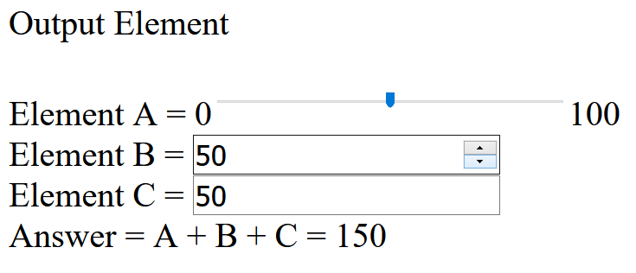
Anyone tried the challenge?

Slide 3
Information
All HTML elements can have attributes
They provide additional information about the elements itself.
They are ALWAYS specified in the start tag.
They come in a name/value pair e.g. name=‘value’.
Note: it is good practise to have all the style attributes written in a separate file called .css (which we will cover more in details when we go into CSS)

Slide 4
‘id’ attribute
As its name suggest, it s an identifier.
It is GLOBALLY UNIQUE.
It is CASe-senSItIVe!

Slide 5
‘class’ attribute
Similar to id, but it is not globally unique.
Remember class in c++?
They have similar functionality.
Think of it as a blueprint for the webpage.
You can mix both <id> and <class> together.

Slide 6
Semantics
<header> | Introduction for the whole page or individual sections, article, nav, aside elements. Typically contains site name, logo, navigation. Does not have to be at the beginning of page. | <header> <h1>The Importance of Being Earnest</h1> <h3>A Quest for Truth and Beauty</h3> <p>The play was written in 1895 by playwright Oscar Wilde</p> </header>

Slide 7
Semantics
<footer> | Includes typical footer information like authoring, copyrights, contact information and a footer menu. | <footer> <p>Written by: Oscar Wilde</p> <p>Contact information: <a href="mailto:oscar@wilde.com"> oscar@wilde.com</a>.</p> </footer>

Slide 8
Semantics
<nav> | Navigation links for the document. A page can have more than one <nav> element like table of contents, horizontal navigation in header and footer navigation. | <nav><ol> <li><a href="/act1/">Act 1</a></li> <li><a href="/act2/">Act 2</a></li> <li><a href="/act3/">Act 3</a></li> </ol></nav>

Slide 9
Semantics
<section> | Defines sections in the document such as chapters, headers, etc. Typically used on content that cannot make sense on its own. | <section> <h1>Act 1 - Scene 1</h1> <p>Set in the morning room of Algy's flat in Half Moon Street</p> </section>

Slide 10
Semantics
<article> | Defines independent content that should make sense on its own outside of the document such as newspaper articles, blog posts, etc. | <article> <h1>A blogger's analysis of this brilliant satire</h1> <p>This witty, sometimes conscious play is Wilde's playground to raise his progressive sentiments...</p> </article>

Slide 11
Semantics
<aside> | Side content other than main content, like a sidebar. These are not considered as part of the main page outline. | <p>Algernon's flat is luxuriously and artistically furnished</p> <aside> <h3>Algernon Moncrieff</h3> <p>A wealthy bachelor who lives in a fashionable part of London. He has a good sense of humor and utter lack of respect for society.</p> </aside>

Slide 12
Guided Example
Description of what each tags represent on the webpage.

